Slide 1

Predicting 30-Day Hospital Readmission for Diabetes Patients Group 3: Sahil Niranjan, Nimisha Sharma, Laxmi Priya Samal, Junhui Hu ALY6040 Data Mining College of Professional Studies, Northeastern University Professor: Kasun Samarasinghe 25th June, 2025

Slide 2
Real-World Problem – Nimisha
Challenge: Hospitals often deal with unplanned readmissions that increase costs and affect patient recovery.
Why diabetes? People with diabetes are more likely to come back within 30 days because their condition is harder to manage.
Our goal: Build a model to spot these high-risk patients early and help prevent readmissions.

Slide 3
Dataset Overview and EDA – Laxmi
Dataset: UCI Diabetes 130-US hospitals (diabetic_data.csv)
Scope: 100,000+ inpatient admissions (1999–2008)
Features: Demographics, diagnoses, procedures, medications
Objective: Predict risk of patient readmission within 30 days
Why this dataset? Real-world hospital data offering diverse patterns to explore clinical predictors and support outcome-based modeling

Slide 4
Data Preparation - Laxmi
Target Defined: Converted readmission to binary (<30 days = 1, else = 0)
Cleaned Data: Dropped columns with too many missing values or no useful variance
One-Hot Encoding: Transformed categorical features to numeric — avoids misleading order assumptions
Outcome: Ready, structured dataset aligned to prediction goal

Slide 5
Feature Engineering – nick
Flags patients who had more than one hospital visit (inpatient, emergency, or outpatient) during the data period.
Flags patients who had more medications prescribed than the average.
To avoid duplicate features, any pre-existing columns indicating insulin status are dropped, flags any patient who is on any type of insulin regimen (Steady, Up, Down)
Notes:
Base on our eda, we find some features that has high association with readmit, so we want dig more on them
The first, we Flags patients who had more than one hospital visit
The average medications is calculated over the whole dataset, and patients above this threshold are marked as 1.
And we create new feature, If a patient is flagged in any of the three insulin columns, insulin_user becomes 1; otherwise, 0.

Slide 6
Train-Validation-Test Splitting Strategy
Why three-way split?
Training set to build the model.
Validation set to fine-tune hyperparameters and prevent overfitting.
Test set to evaluate generalization performance on completely unseen data.
Employed a stratified three-way split to maintain the distribution of readmissions:
Training set: 64%
Validation set: 16%
Test set: 20%
Notes:
In traditional two-way splits, the dataset is divided into a training set and a test set
However, the training process often involves extensive hyperparameter tuning and model adjustments, including threshold optimization
If we tune our model using the test set, we risk overfitting to the test data, which compromises the model’s ability to generalize

Slide 7
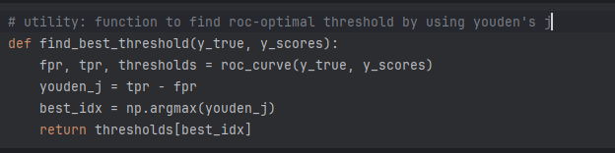
Finding the ROC-Optimal Threshold Using Youden’s J Statistic nick
Why Not Just Use Threshold = 0.5?
In imbalanced datasets (like ours), a default threshold of 0.5 often favors the majority class.
This leads to extremely poor recall for the minority class (e.g., readmitted patients).
Youden’s J: Maximize true positive rate while minimizing false positive rate
Notes:
Before we started tuning our models, we realized that we would need a consistent way to evaluate performance beyond just using the default threshold of 0.5.
Especially since we’re dealing with an imbalanced dataset, using 0.5 as a cutoff often gives us very poor recall on the positive class.
So we created a reusable function to find the best classification threshold based on the ROC curve. This was done using Youden’s J statistic
In screenshot, we use roc_curve() to get arrays of true positive and false positive rates at various thresholds. Then, we compute the J score as TPR - FPR, and we select the threshold where this difference is the largest.

Slide 8

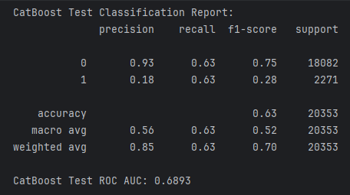
CatBoost - Final Model Performance Summary nick
Best Estimator Parameters:
Depth: 6
Iterations: 300
Learning Rate: 0.1
ROC-optimal threshold determined to be 0.108, which improved recall of class 1 to 0.63
Validation Results Comparison
Accuracy dropped from 0.89 → 0.64
Recall improved significantly (from 0.02 → 0.63), at the cost of lower precision
Macro F1 Score improved from 0.49 to 0.63
Notes:
CatBoost is specifically designed to process categorical features which are very common in healthcare datasets
Best Estimator Parameters were selected using GridSearchCV. We tested 8 parameter combinations across 3-fold cross-validation. And set scoring='f1’ (mean of precision and recall). n_jobs=-1, really base on ur CPU.
The best parameters were a depth of 6, 300 iterations, and a learning rate of 0.1.
After Validation performance at threshold=0.5, recall for the positive class is only 2%. which is unacceptable for our goal
After threshold tuning, recall on the validation set improved dramatically to 0.63. While accuracy dropped from 0.89 to 0.64, the model became much more effective at identifying positive cases.
The macro F1 score also improved from 0.49 to 0.63, indicating a better balance between precision and recall.
Now, looking at the test dataset — we applied the same threshold and evaluated final performance. The test recall for the positive class remained at 0.63, and a ROC AUC of 0.6893.
This shows that our threshold tuning generalized well beyond the validation set, the model is effective at ranking high-risk vs. low-risk cases, but there’s room for improvement.

Slide 9
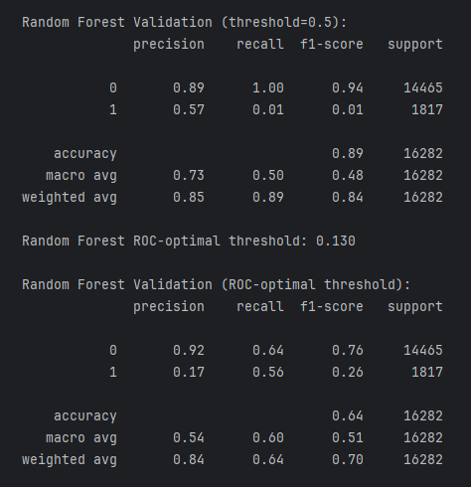
Random Forest – Final Model Performance
Threshold tuning (0.5 → 0.130) improved recall for readmitted patients (Class 1) from 0.01 to 0.56
Accuracy dropped slightly (0.89 → 0.64), but the model became more balanced and useful for real-world healthcare decisions

Slide 10
DECISION TREE - Sahil
max_depth : None
Enables the tree to reach its greatest potential and aids in capturing intricate relationships. But it might also make overfitting more likely.
min_samples_split: 2
The model can split aggressively and learn fine-grained patterns by using the smallest split size permitted.
min_samples_leaf: 1
One observation can be represented by a leaf. Despite its flexibility, it becomes more sensitive to noise.
Why this matters: To determine the optimal hyperparameters that maximize F1-score—which helps balance precision and recall and is particularly important in imbalanced datasets—we performed 108 combinations using 3-fold CV.
Threshold Tuning Using ROC-Optimal Value:
Recall for the minority class is decreased by a default categorization threshold of 0.5, which tends to favour the majority class.
To determine the threshold that maximizes (True Positive Rate – False Positive Rate), we used Youden's J statistic.
Recall for Class 1 was marginally enhanced by the ROC-optimal threshold of 1.0.
Why this matters: When it comes to healthcare issues, where false negatives (such as failing to detect a condition) can be expensive, selecting the appropriate threshold is just as crucial as the model itself.

Slide 11
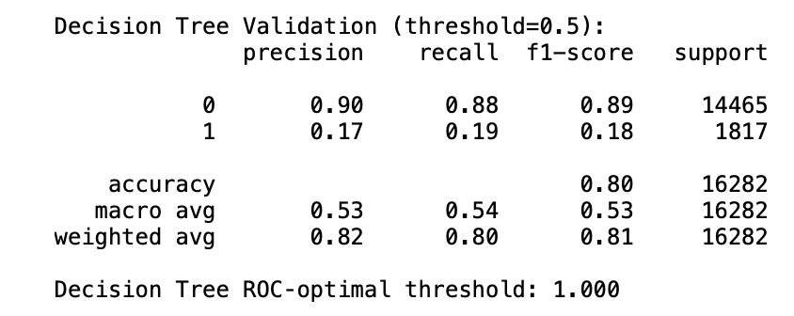
DECISION TREE - Sahil
Threshold Tuning Using ROC-Optimal Value
Default threshold (0.5) biased toward majority class, hurting Class 1 recall.
Applied Youden’s J statistic to find the optimal threshold: 1.0
Slight recall improvement for minority class.
Why this matters: When it comes to healthcare issues, where false negatives (such as failing to detect a condition) can be expensive, selecting the appropriate threshold is just as crucial as the model itself.
Why this matters:
Although the model is very accurate, it only represents performance on the majority class, which is misleading.
The Class 1 F1-score (0.18) is too low, indicating the model fails to generalize well for underrepresented classes.
Macro average F1-score (0.53) gives equal weight to both classes, showing the model’s true performance.

Slide 12
Rationale Behind: Decision Tree
Interpretation & Rationale:
Decision Tree was selected as a robust baseline model due to its ease of interpretation and simplicity.
Its limitations on imbalanced datasets were expected—The low recall for Class 1 can be explained by overfitting to the majority class.
Despite tuning and ROC-threshold adjustment, minority class detection remained weak.
The shift to ensemble approaches like CatBoost and XGBoost, which are more appropriate for managing class imbalance through boosting techniques, was spurred by these drawbacks.

Slide 13
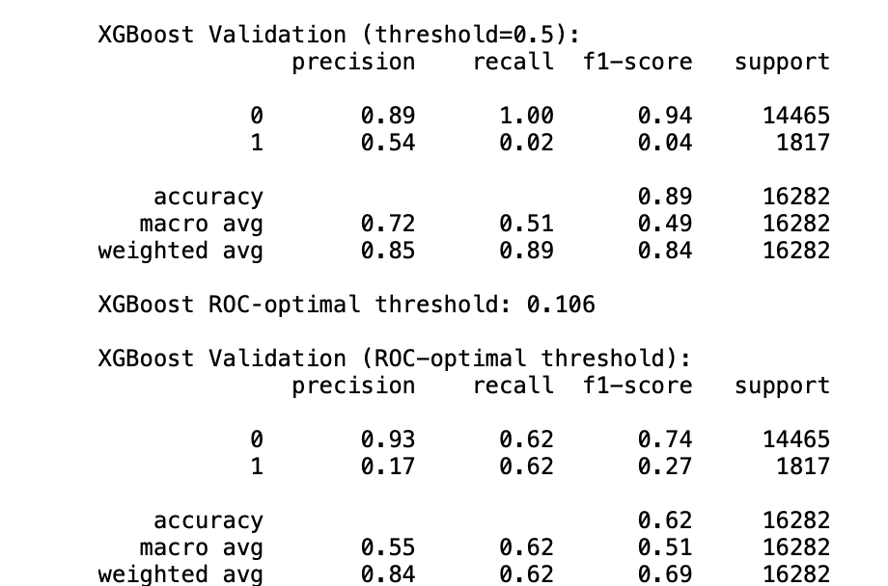
XGBoost – Sahil
Threshold Tuning
Default threshold = 0.5 led to poor recall for Class 1 (recall = 0.02)
ROC-optimal threshold = 0.106 (found via Youden’s J statistic)
Improved Class 1 recall to 0.62, precision = 0.17
Test Set Classification Performance
Best Estimator Parameters (via GridSearchCV)
n_estimators: 200
learning_rate: 0.1
max_depth: 7
subsample: 1.0
colsample_bytree: 0.8
Total of 48 combinations tested over 3-fold CV = 144 fits
Optimization metric: F1-score, chosen to address class imbalance

Slide 14
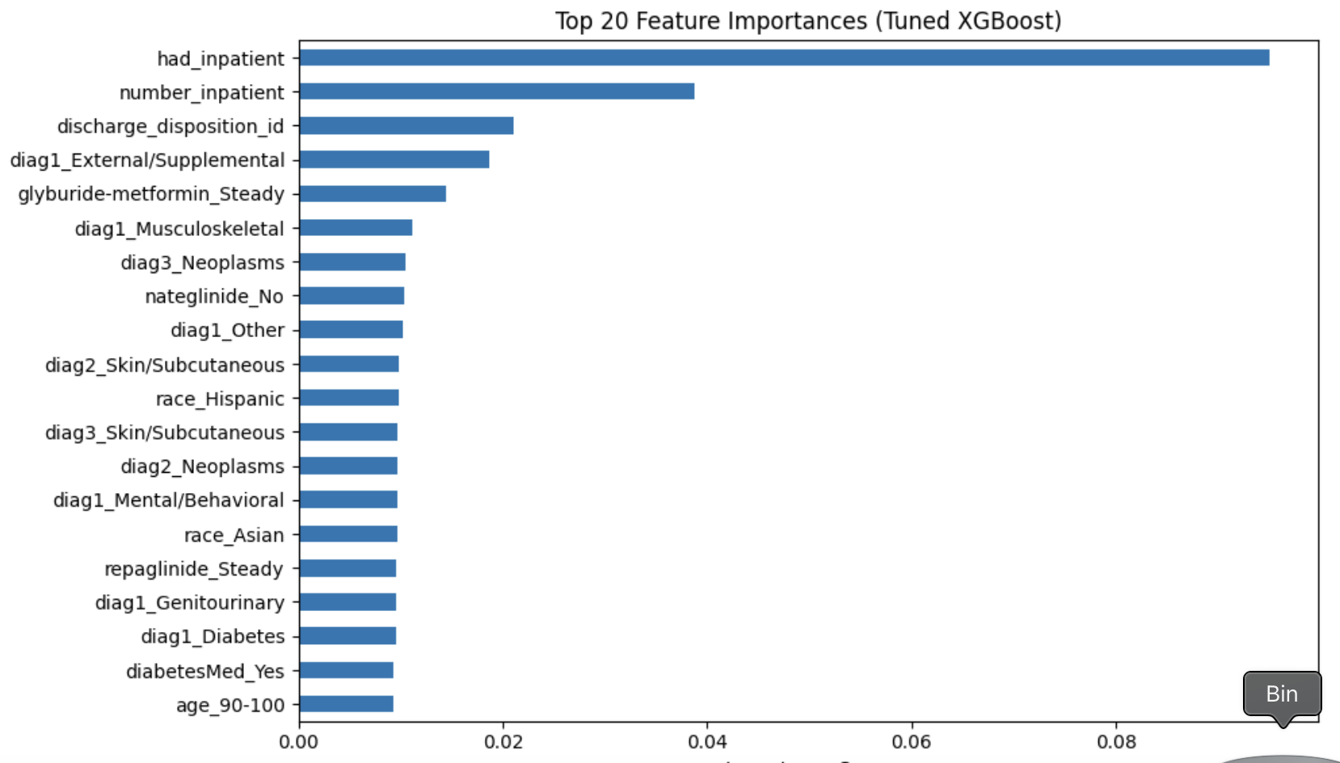
XGBoost - Sahil
Top 5 Most Important Features (based on feature importance score):
had_inpatient – 0.095
number_inpatient – 0.039
discharge_disposition_id – 0.021
diag1_External/Supplemental – 0.019
glyburide-metformin_Steady – 0.014
Why XGBoost?
Significantly improved recall for Class <30 After adjusting, recall rose from 0.02 at the default threshold to 0.65, significantly improving the detection of early readmissions.
Captured complex clinical interactions XGBoost modeled non-linear correlations between characteristics like discharge disposition and past inpatient experience.
Produced clinically meaningful feature rankings Important features like had_inpatient and number_inpatient
Delivered balanced and robust performance Achieved strong test metricss ubstantially lower overfitting risk, such as a macro F1-score of 0.51 and a ROC AUC of 0.686.
Proved to be the most practical and adaptable model
It was appropriate for real-world applications since it outperformed baseline models and permitted threshold tweaking.

Slide 15
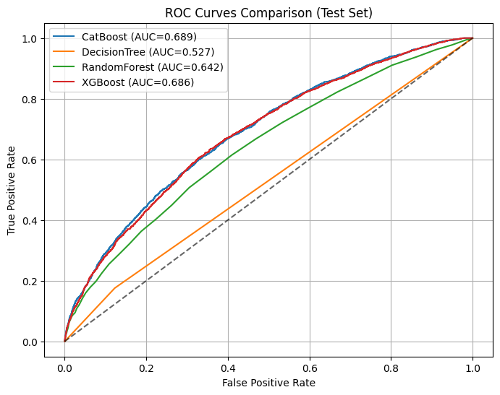
ROC Curve Comparison
Key Observations:
CatBoost: Highest AUC (0.689), slightly better than XGBoost
XGBoost: AUC = 0.686, strong class separation
Random Forest: Moderate performance (AUC = 0.642)
Decision Tree: Weak performance (AUC = 0.527), close to random guessing
Conclusion: XGBoost provided a strong balance of interpretability, accuracy, and recall—making it a preferred model for deployment consideration.

Slide 16
Conclusion
Simpler models were unable to detect patterns that our top model, XGBoost, was able to. Patients with several hospitalizations during the last year (number_inpatient), prior inpatient visits (had_inpatient), and particular discharge codes, for example, were identified as high risk. Even though a standard decision tree would have missed it, XGBoost accurately identified a patient who was just discharged from an inpatient stay and was prescribed constant insulin therapy as being at high risk for readmission.
Although no model is flawless, our refined method shown that threshold improvement can significantly increase recall, allowing us to identify more readmission cases that would otherwise go unnoticed. Predictive modeling is genuinely useful in healthcare settings because it strikes a compromise between interpretability, performance, and therapeutic relevance.

Slide 17
THANK YOU!!

